Slide 1
Understanding the new GDPR for Travel Companies
Presented by Jeff Ment

Slide 2
What is the Problem?
Recent Headlines:
“Uber's license revoked in Brighton over data breach handling” IT Pro (5/2/18)
“If you shopped at these 14 stores in the last year, your data might have been stolen.” Business Insider (4/6/18)
“What to Know About the Latest Data Breach Hitting Sears and Delta Customers” Fortune (4/5/18)

Slide 3
What is the problem?
Effect on Consumers
Hackers search for data listed below because they can be used to make money by duplicating credit cards, and using personal information for fraud, identity theft , and even blackmail. They can also be sold in bulk in deep web marketplaces.
Member name
Date of birth
Social Security number
Member identification numbers
Email address
Mailing and/or physical address
Telephone numbers
Banking account numbers
Clinical information
Claims information

Slide 4
What is the Problem?
How Does a Data Breach Effect Business?
A study by KPMG found that 19% of consumers would completely stop shopping at a retailer after a breach.
33% would take an extended break from shopping at the retailer.

Slide 5
2017 Ponemon Cost of Data Breach Study
Average cost per stolen record - $141.00
Average size of data breach has risen 1.8% to more than 24,000 records per breach.
How Much Will a Breach Cost You?

Slide 6
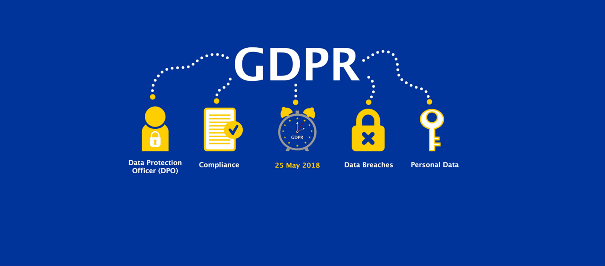
The General Data Protection Regulation

Slide 7
What is the GDPR
Under the European Charter of Fundamental Rights Article 8(1) the protection of natural persons with regard to the processing of personal data is a fundamental right.
Prior to the GDPR this right was protected by the Data Protective Directive.
The GDPR expands on the DPD and requires additional elements of protection.

Slide 8
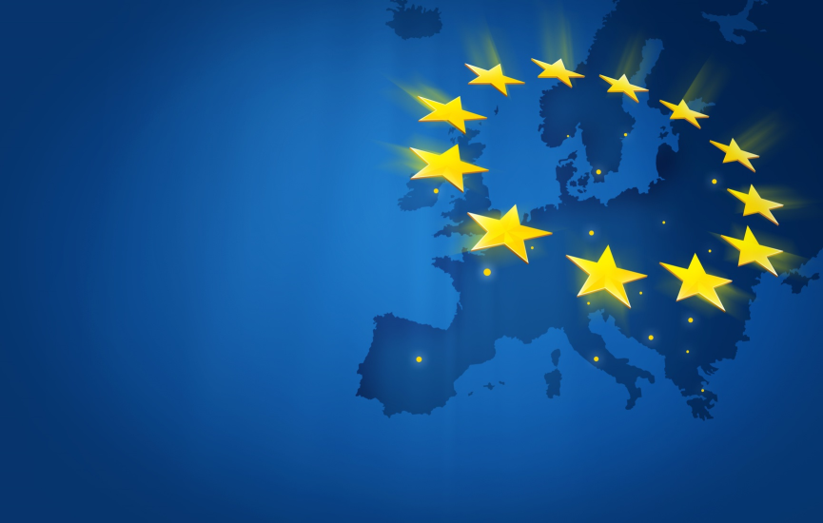
What Countries Compose the European Union?
Countries
Austria | Italy
Belgium | Latvia
Bulgaria | Lithuania
Croatia | Luxembourg
Cyprus | Malta
Czech Republic | Netherlands
Denmark | Poland
Estonia | Portugal
Finland | Romania
France | Slovakia
Germany | Slovenia
Greece | Spain
Hungary | Sweden
Ireland | United Kingdom

Slide 9
Does the GDPR Apply to Me?
All EU Citizens
All EU Companies
All Non- EU Companies that offer goods and/or services or monitor the behavior of EU data subjects

Slide 10
Expanded View of “Personal Data”
Personal Data includes anything that relates to the person’s identity:
Name
Email Address
Bank Details
Social Media Updates
Medical History
Computer IP Address

Slide 11
Collection of Personal Data
GDPR

Slide 12
Personal Data in a Typical Online Travel Reservation

Slide 13
Personal Data in a Typical Online Travel Reservation

Slide 14
When Can I Collect Personal Data?
Three conditions for gathering personal data
Allowable under Legitimate Legal Basis
Consent
Public Interest

Slide 15
When Can I Collect Personal Data?
Allowable under Legitimate Legal Basis (Article 6):
Necessary for performance of a contract
This covers collecting information in order to book the tour, make reservations and charge the customer.

Slide 16
Obtaining Consent
When do I need Consent?
If you plan to use the data for later marketing then you need consent.
If you share data with others

Slide 17
Obtaining Consent
Consent
Distinguishable from other matters
Intelligible and easily accessible form
Clear and plain language
Right to withdraw consent at any time
Performance of the contract cannot be conditioned on consent to process personal data that is not necessary to the performance of the contract

Slide 18
Sample Consent for Future Marketing from the individual company
I have read and accepted the terms & conditions
At Tours, Tours, Tours we’d love to keep in touch with you about new destinations and services that we think you would want to hear about. We will treat your data with respect and you can find out the details in our privacy policy.
Yes, I would like to receive updates from Tours, Tours, Tours
No, Please do not send me updates from Tours, Tours, Tours.
By the way, if you change your mind, you can stop receiving updates at any time by contacting us at stopthemarketing@toomanyemails.com

Slide 19
Sample Consent for Future Marketing from Third Parties
I have read and accepted the terms & conditions
At Tours, Tours, Tours we’d love to keep in touch with you about new destinations and services that we think you would want to hear about. We will treat your data with respect and you can find out the details in our privacy policy.
Yes, I would like to receive updates from Tours, Tours, Tours
Yes, I would like to receive updates from Il Favoloso Hotel
No, Please do not send me updates from Tours, Tours, Tours.
No, Please do not send my updates from Il Favoloso Hotel
By the way, if you change your mind, you can stop receiving updates at any time by contacting us at stopthemarketing@toomanyemails.com

Slide 20
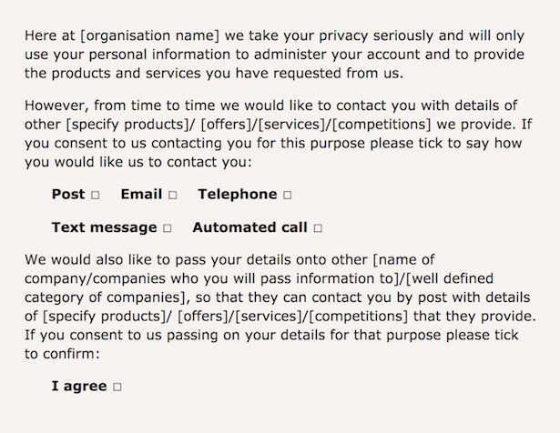
Sample Consent from ICO

Slide 21
What about minors?
Consent for Minors
Consent for children under 16 must be given by the parent of legal guardian of the child.
The same rules of consent apply.

Slide 22
What about medical information?
Medical Information
Allergies, Diabetes, Medical problems.
You may have a legitimate purpose during the tour but should be deleted upon completion.

Slide 23
The Right to Be Forgotten
Under GDPR individuals have the right to be forgotten.
If an individual requests that their data be scrubbed you must comply unless there is a legal purpose for retaining the data.

Slide 24
Third Parties and Consent
Contract with third parties
Only disclose necessary data.
Third party will be responsible for data and destroy it when legitimate purpose is complete.
Third party will obtain their own consent for marketing.
It is unwise to take responsibility for third party consent.

Slide 25
Privacy Policy
GDPR

Slide 26
Privacy Policy
The consent should link to the privacy policy that contains detailed information about how the data is used, stored, etc.

Slide 27
Privacy Policy
What is in the Privacy Policy?
Identity and contact information of the business storing data
The purpose of the processing and the legal basis
Recipients or categories of recipients of the data it any
The period for which data will be stored
Right to access and erasure of data (No Charge)
Right to withdraw consent at anytime
Right to lodge a complaint
Whether the data will be processed for any purpose other than for the purpose it was collected

Slide 28
Tours, Tours, Tours Privacy Policy
Answer why:
This Policy explains when and why we collect personal information about people who visit our website, how we use it, the conditions under which we may disclose it to others and how we keep it secure.
We may change this Policy from time to time so please check this page occasionally to ensure that you’re happy with any changes. By using our website, you’re agreeing to be bound by this Policy.
Any questions regarding this Policy and our privacy practices should be sent by email to contact@tourstourstours.com or by writing to 1 Great View, Tourspot, Great State 00160, you can telephone (999) 999-9999.

Slide 29
Tours, Tours, Tours Privacy Policy
Tell them who you are:
We’re Tours, Tours, Tours, Great State’s largest tour operator dedicated to providing our customers with wonderful touring experiences. Tours, Tours, Tours is a limited liability company registered in Great State and operating with our tour partners throughout the United State and Europe. We work with over 100 subcontractors that include hoteliers and transportation companies. Also list subsidiaries here.

Slide 30
Tours, Tours, Tours Privacy Policy
How is Personal Data Collected:
We obtain information about you when you use our website, for example, when you contact us about tours, to book a reservation, or if you register to receive our emails.
Tell them every instance that results in data collection.

Slide 31
Tours, Tours, Tours Privacy Policy
What Type of Information is Collected:
The personal information we collect might include your name, address, email address, IP address, and information regarding what pages are accessed and when. If you make a payment online or purchase a product from us, your card information is not held by us, it is collected by our third party payment processors, who specialize in the secure online capture and processing of credit/debit card transactions, as explained below.

Slide 32
Tours, Tours, Tours Privacy Policy
How is Your Information Used:
We may use your information to:
process a payment that you have made;
Process bookings and reservations for your selected tour;
to carry out our obligations arising from any contracts entered into by you and us;
seek your views or comments on the services we provide;
notify you of changes to our services;
send you communications which you have requested and that may be of interest to you. These may include information about tours and promotions we think you will find interesting;
We review our retention periods for personal information on a regular basis. We will hold your personal information on our systems for as long as is necessary for the relevant activity, or as long as is set out in any relevant contract you hold with us.

Slide 33
Tours, Tours, Tours Privacy Policy
Who Has Access To Your Information:
We will not sell or rent your information to third parties.
We will not share your information with third parties for marketing purposes.
Third Party Service Providers working on our behalf: We may pass your information to our third party service providers, agents subcontractors and other associated organizations for the purposes of completing tasks and providing services to you on our behalf (for example to book reservations for your tour). However, when we use third party service providers, we disclose only the personal information that is necessary to deliver the service and we have a contract in place that requires them to keep your information secure and not to use it for their own direct marketing purposes. Please be reassured that we will not release your information to third parties beyond the Tours, Tours, Tours network for them to use for their own direct marketing purposes, unless you have requested us to do so, or we are required to do so by law, for example, by a court order or for the purposes of prevention of fraud or other crime.
When you are using our secure online payment pages, your payment is processed by a third party payment processor, who specializes in the secure online capture and processing of credit/debit card transactions. If you have any questions regarding secure transactions, please contact us.

Slide 34
Tours, Tours, Tours Privacy Policy
Consent and Opt Out:
You have a choice about whether or not you wish to receive information from us. If you do not want to receive direct marketing communications from us about tours and exciting travel opportunities, then you can select your choices by ticking the relevant boxes situated on the form on which we collect your information.
We will not contact you for marketing purposes by email, phone or text message unless you have given your prior consent. We will not contact you for marketing purposes by post if you have indicated that you do not wish to be contacted. You can change your marketing preferences at any time by contacting us by email: stopthemarketing@toomanyemails.com or telephone us at (999) 999-9999.

Slide 35
Tours, Tours, Tours Privacy Policy
How to Access Your Information:
The accuracy of your information is important to us. We’re working on ways to make it easier for you to review and correct the information that we hold about you. In the meantime, if you change email address, or any of the other information we hold is inaccurate or out of date, please email us at: contact@tourstourstours.com, or write to us at: 1 Great View, Tourspot, Great State . Alternatively, you can telephone (999) 999-9999.
You have the right to ask for a copy of the information Tours, Tours, Tours hold about you.

Slide 36
Tours, Tours, Tours Privacy Policy
How to Access Your Information:
When you give us personal information, we take steps to ensure that it’s treated securely. Any sensitive information (such as credit or debit card details) is encrypted and secure by design.
Non-sensitive details (your email address etc.) are transmitted normally over the Internet, and this can never be guaranteed to be 100% secure. As a result, while we strive to protect your personal information, we cannot guarantee the security of any information you transmit to us, and you do so at your own risk. Once we receive your information, we make our best effort to ensure its security on our systems. Where we have given (or where you have chosen) a password which enables you to access certain parts of our websites, you are responsible for keeping this password confidential. We ask you not to share your password with anyone.

Slide 37
Tours, Tours, Tours Privacy Policy
Profiling:
We may analyze your personal information to create a profile of your interests and preferences so that we can contact you with information relevant to you. We may make use of additional information about you when it is available from external sources to help us do this effectively. We may also use your personal information to detect and reduce fraud and credit risk.

Slide 38
Tours, Tours, Tours Privacy Policy
Use of Cookies:
Like many other websites, the Tours, Tours, Tours website uses cookies. 'Cookies' are small pieces of information sent by an organization to your computer and stored on your hard drive to allow that website to recognize you when you visit. They collect statistical data about your browsing actions and patterns and do not identify you as an individual. For example, we use cookies to store your country preference. This helps us to improve our website and deliver a better more personalized service.
It is possible to switch off cookies by setting your browser preferences. For more information on how to switch off cookies on your computer, visit our full cookies policy. Turning cookies off may result in a loss of functionality when using our website.

Slide 39
Tours, Tours, Tours Privacy Policy
Links to Other Websites:
Our website may contain links to other websites run by other organizations. This privacy policy applies only to our website‚ so we encourage you to read the privacy statements on the other websites you visit. We cannot be responsible for the privacy policies and practices of other sites even if you access them using links from our website.
In addition, if you linked to our website from a third party site, we cannot be responsible for the privacy policies and practices of the owners and operators of that third party site and recommend that you check the policy of that third party site.

Slide 40
Tours, Tours, Tours Privacy Policy
Users Under 16:
We are concerned to protect the privacy of children aged 16 or under. If you are aged 16 or under‚ please get your parent/guardian's permission beforehand whenever you provide us with personal information.

Slide 41
Tours, Tours, Tours Privacy Policy
Outside of the EU:
As part of the services offered to you through this website, the information which you provide to us may be transferred to countries outside the European Union (“EU”). By way of example, as a United States Company our servers are located in the United States, which does not have similar data protection laws to the EU. By submitting your personal data, you’re agreeing to this transfer, storing or processing. We will take steps to ensure that appropriate security measures are taken with the aim of ensuring that your privacy rights continue to be protected as outlined in this Policy.
If you use our services while you are outside the EU, your information may be transferred outside the EU in order to provide you with those services.

Slide 42
Storage of Personal Data
GDPR

Slide 43
Compliance with Stored “Personal Data”
Compliance with Stored Personal Data:
Keep a record of all current and existing data
How and when the individual provided consent (this is going forward, not retroactive)
How the data is being protected (By Secure By Design)
You want encryption and firewalls
Probably don’t need pseudonymization
How the data is being used
Need a legitimate reason for keeping the data, includes marketing by consent.
Monitoring protocols to avoid breach

Slide 44
Compliance with Stored “Personal Data”
What to Do Right Now:
Audit
Full Audit of all data held, how it is handled and how collected, what it is used for and how it is securely stored
You should be able to get this information with your web designer. You should work with them to ensure that you know the answers to these questions. You should ensure that they understand GDPR and can comply.

Slide 45
Compliance with Stored “Personal Data”
What to Do Right Now:
Determine Adjustments
What is the legal basis of the data currently held
Adjust procedures for obtaining and storing data as necessary
Think about ease of access to destroy data if an individual exercises their right to be forgotten.
Staff needs to understand that personal data should not be shared at will. All of this data is now protected. No emails between staff about John Smith of 21 Devonshire.
Staff should only receive personal data necessary for their job and after use there should be a plan to destroy that data.

Slide 46
Breach
Must report any breach within 72 hours
describe the nature of the personal data breach including where possible, the categories and approximate number of data subjects concerned and the categories and approximate number of personal data records concerned;
communicate the name and contact details of the data protection officer or other contact point where more
information can be obtained;
describe the likely consequences of the personal data breach;
describe the measures taken or proposed to be taken by the controller to address the personal data breach, including, where appropriate, measures to mitigate its possible adverse effects.
Individuals notified ONLY if “high risk”

Slide 47
Penalties for Non-Compliance
If businesses are not compliant they can be fined up to $20 million or 4% of annual turnover, whichever is higher.

Slide 48
Questions or Comments?
Please Contact Me:
Jeff Ment
(860)969-3200
jment@mentlaw.com

